Slide 1
WSDM - KKBOX’s Music Recommendation SYSTEM
-- Pradeep Joshi
-- Abhishek Goswami
-- Rahul
-- Jose Barajas

Slide 2
Content
Introduction
Problem Statement
Objective
Data Set (Overview)
Data Pre-Processing
Exploratory Data Analysis
EDA Conclusion
Recommendation System
User-based vs Item-based
Item Similarity Matrix
User Similarity Matrix
TPR – FPR Graph
Precision Recall Graph
Challenges/Learnings
In Practice
Conclusion/Future Scope
References

Slide 3
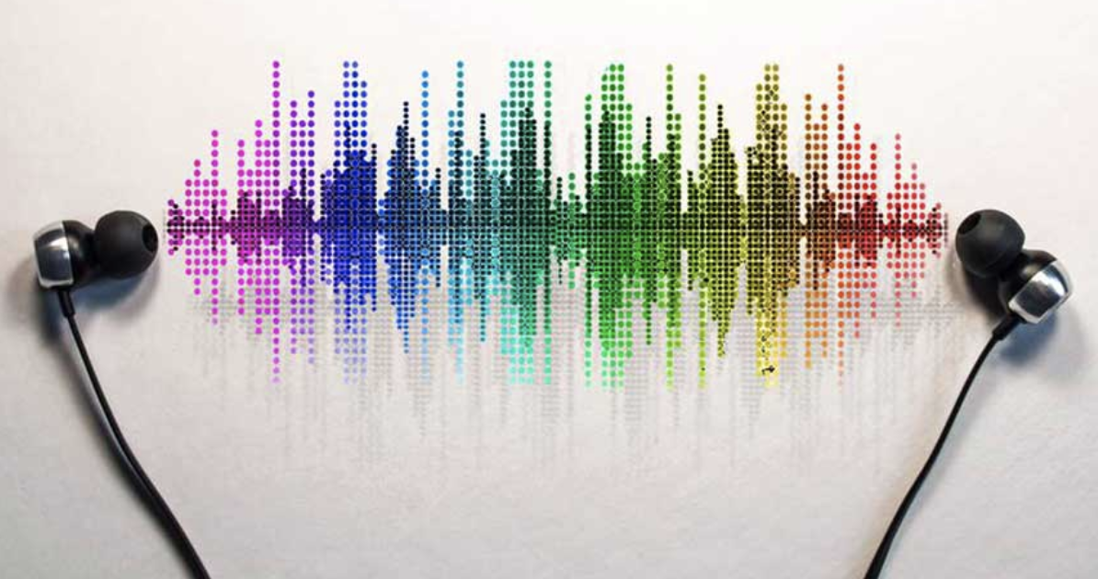
INTRODUCTION
Recommendation is widely used in our daily life. Especially in the e-commerce area, a good recommendation system can help users a lot. In today’s world, every customer is faced with multiple choices. For example, If I’m looking for a book to read without any specific idea of what I want, there’s a wide range of possibilities how my search might pan out. I might waste a lot of time browsing around on the internet and trawling through various sites hoping to strike gold. I might look for recommendations from other people.
But if there was a site or app which could recommend me books based on what I have read previously, that would be a massive help. Instead of wasting time on various sites, I could just log in and voila! 10 recommended books tailored to my taste.
Hence, the topic was chosen because the problem is intuitive to understand. We have a well understanding of the problem from our daily life, which makes us more focused on training methodology.

Slide 4

PROBLEM STATEMENT
Rapid development of mobile devices and internet has made possible for us to access different music resources freely. The number of songs available exceeds the listening capacity of single individual. People sometimes feel difficult to choose from millions of songs. Thus, there is a strong need of a good recommendation system.
Music recommender system learns from the users past listening history and recommends them songs which they would probably like to hear in future. Music streaming services like Pandora, Spotify are now able to collect large amounts of data on the listening habits of their customers and generate revenue by helping their customers discover relevant music.

Slide 5


OBJECTIVE
Data was provided by KKbox, an online music streaming platform based in Taiwan (via Kaggle)
The goal of the project is to create a recommender system for users that provides music recommendations to the users that is in line to what they listen to, but also provide novel recommendations.

Slide 6
DATA SET(Overview)
Provided for was a training set (7.3 million observations) with the User Information (City, Age), Song Information (Length, Genre, Language, Artist), Event Information(System Source, Screen Source, Source Type, Target). Merged the files (train, songs, members) to form a single music data set.
SNo | Data Set | Variables | No of variables | No of Observations
1. | Music | msno, song_id, source_system_tab, source_screen_name, source_type, target, song_length, genre_ids, artist_name, composer, lyricist, language, city, bd, gender, registered_via, expiration_date, membership_days, registration_year, registration_month, registration_date, expiration_year, expiration_month, song_year | 24 | 7377418

Slide 7
DATA PRE-PROCESSING
MUSIC DATA SET
Rows with null values present in msno and song_id were removed.
There are ‘359966’ distinct Songs.
There are ‘30755’ distinct Users.
There are ‘40582’ distinct Artists.
There are ’10’ distinct Languages.
There are ‘572’ distinct Genre.
To conclude, there were lot of songs that were listened to by multiple users. Hence, the user song ratio (30755: 359966).

Slide 8
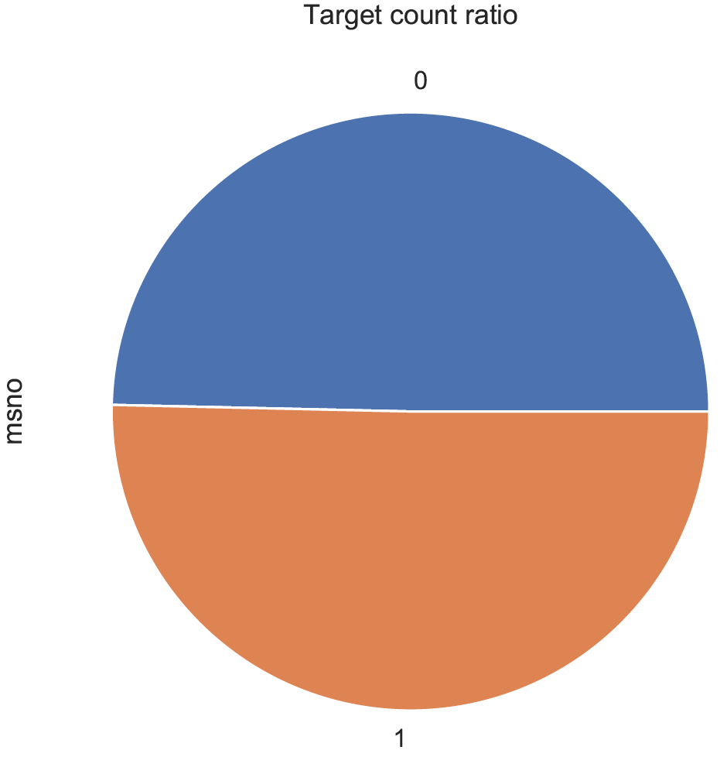
Exploratory Data Analysis (EDA)
TARGET VALUE COUNT

Slide 9
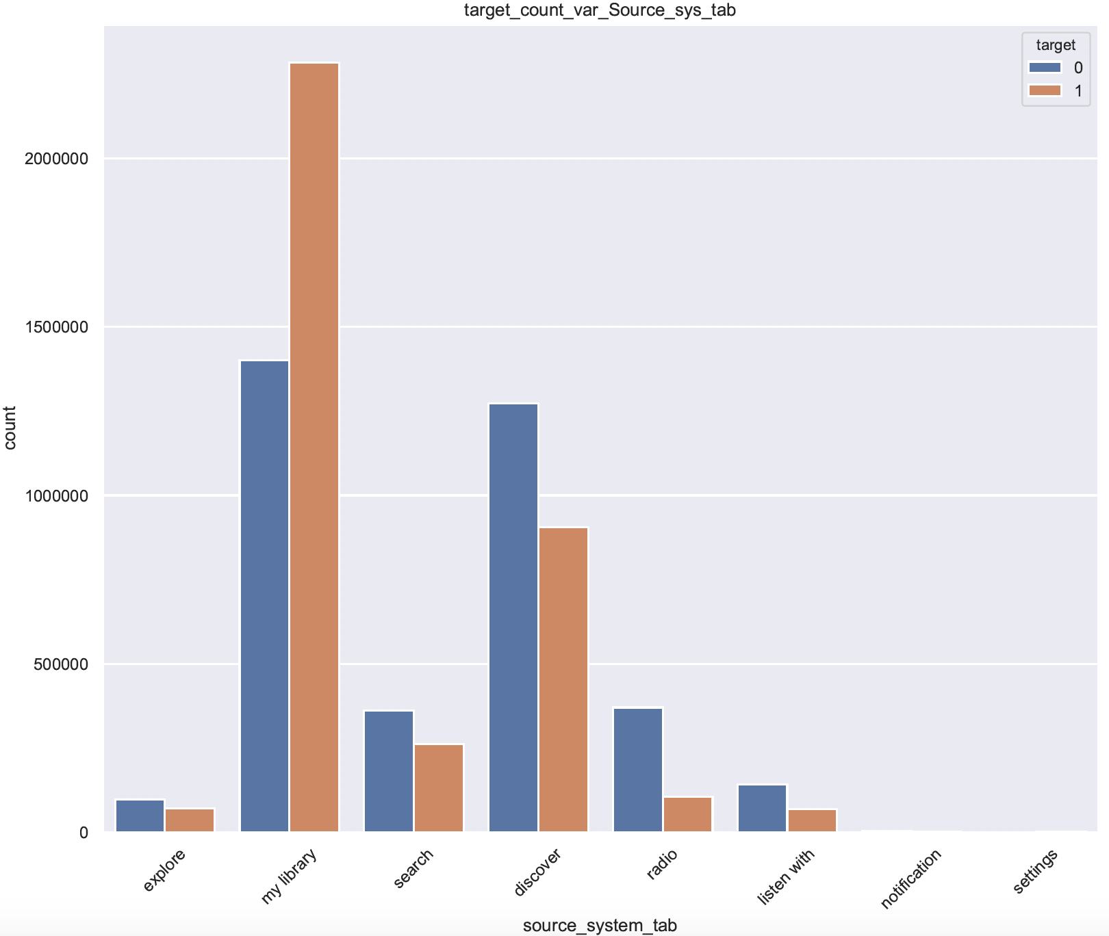
TARGET COUNT VARIATION: SOURCE SYSTEMS TAB

Slide 10
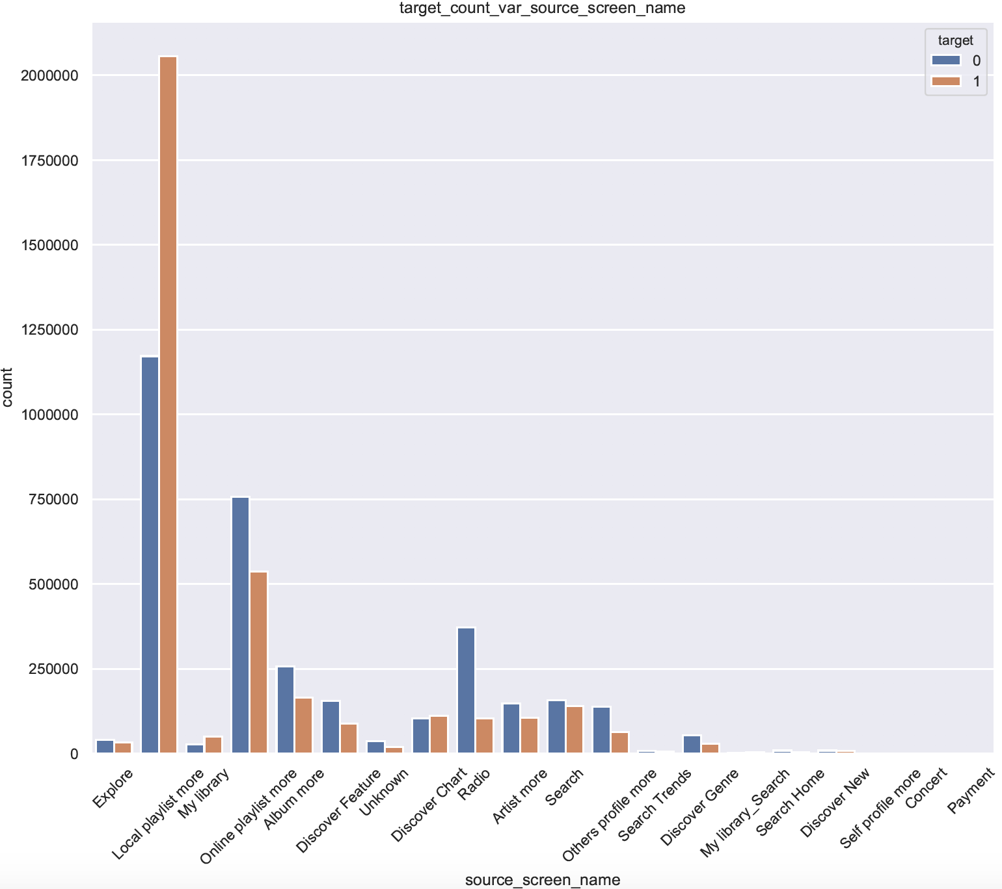
TARGET COUNT VARIATION: SOURCE SCREEN NAME

Slide 11
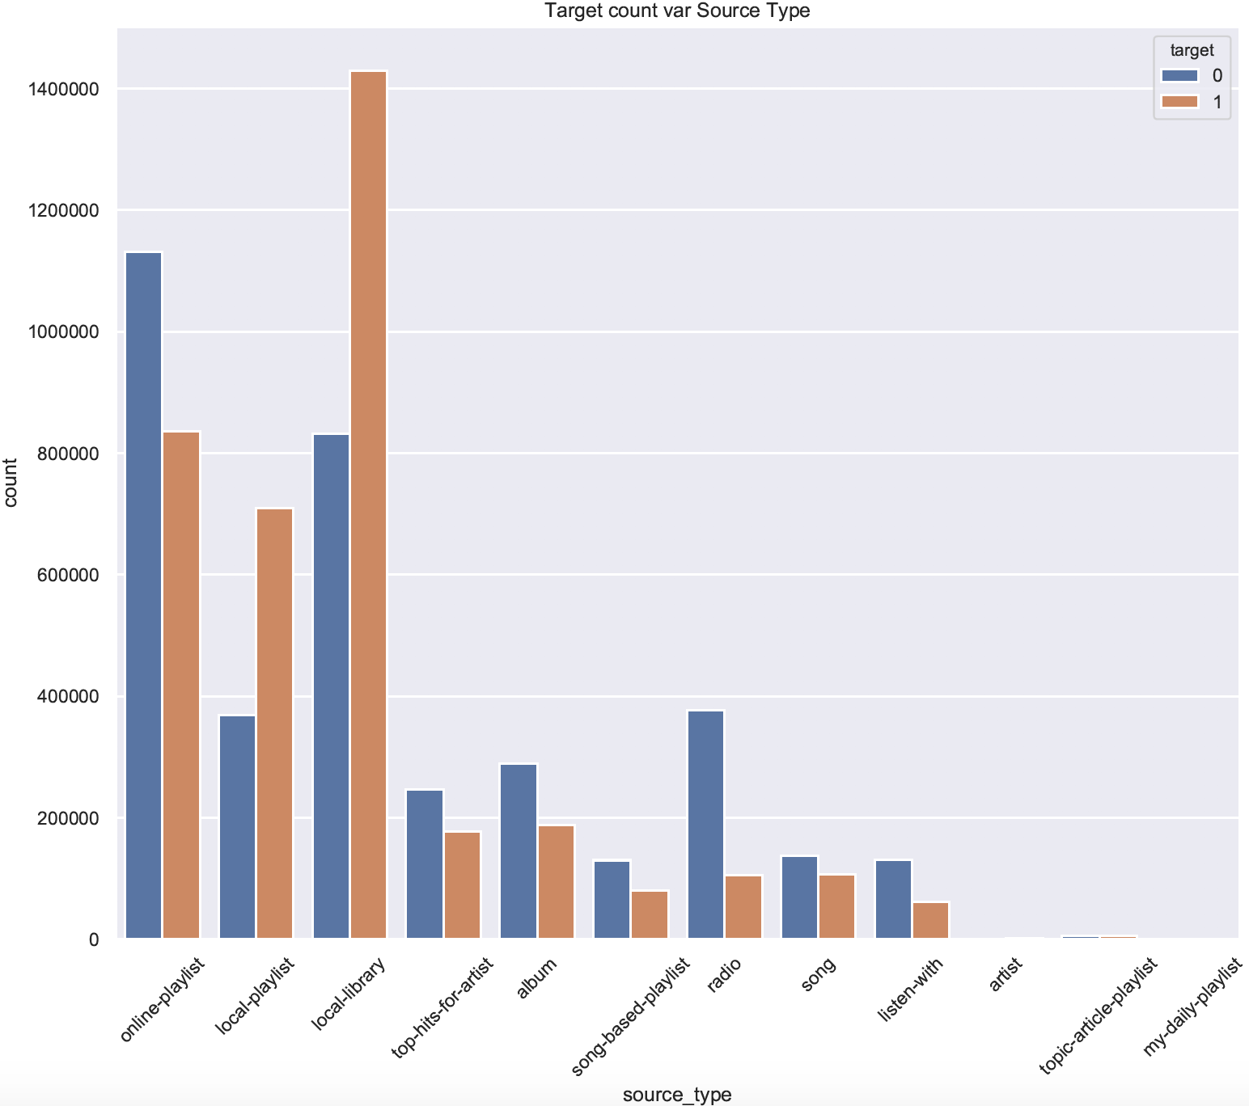
TARGET COUNT VARIATION: SOURCE TYPE

Slide 12
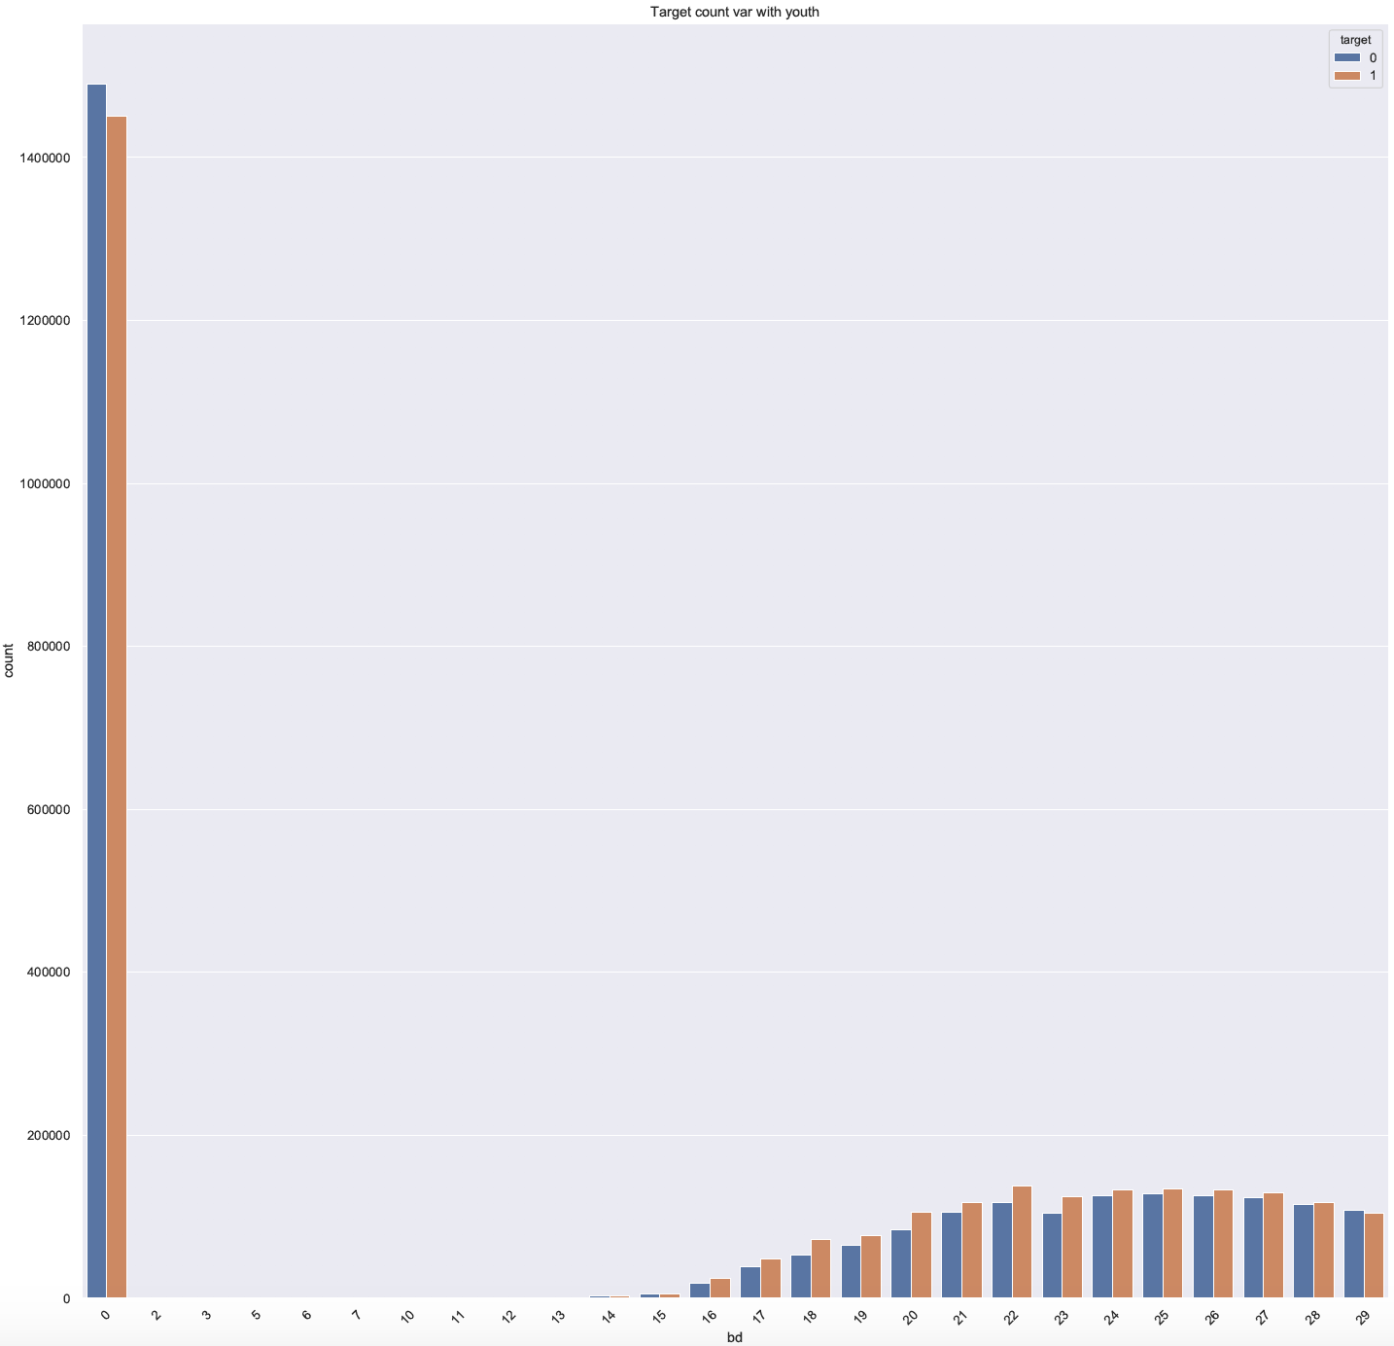
TARGET COUNT VARIATION: AGE

Slide 13
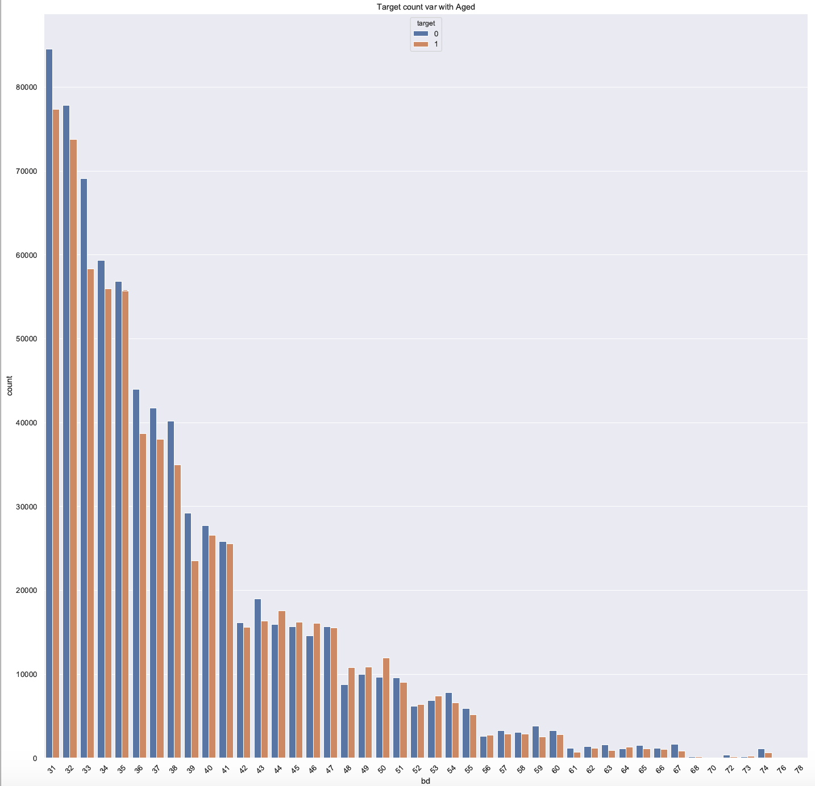
TARGET COUNT VARIATION: AGE

Slide 14
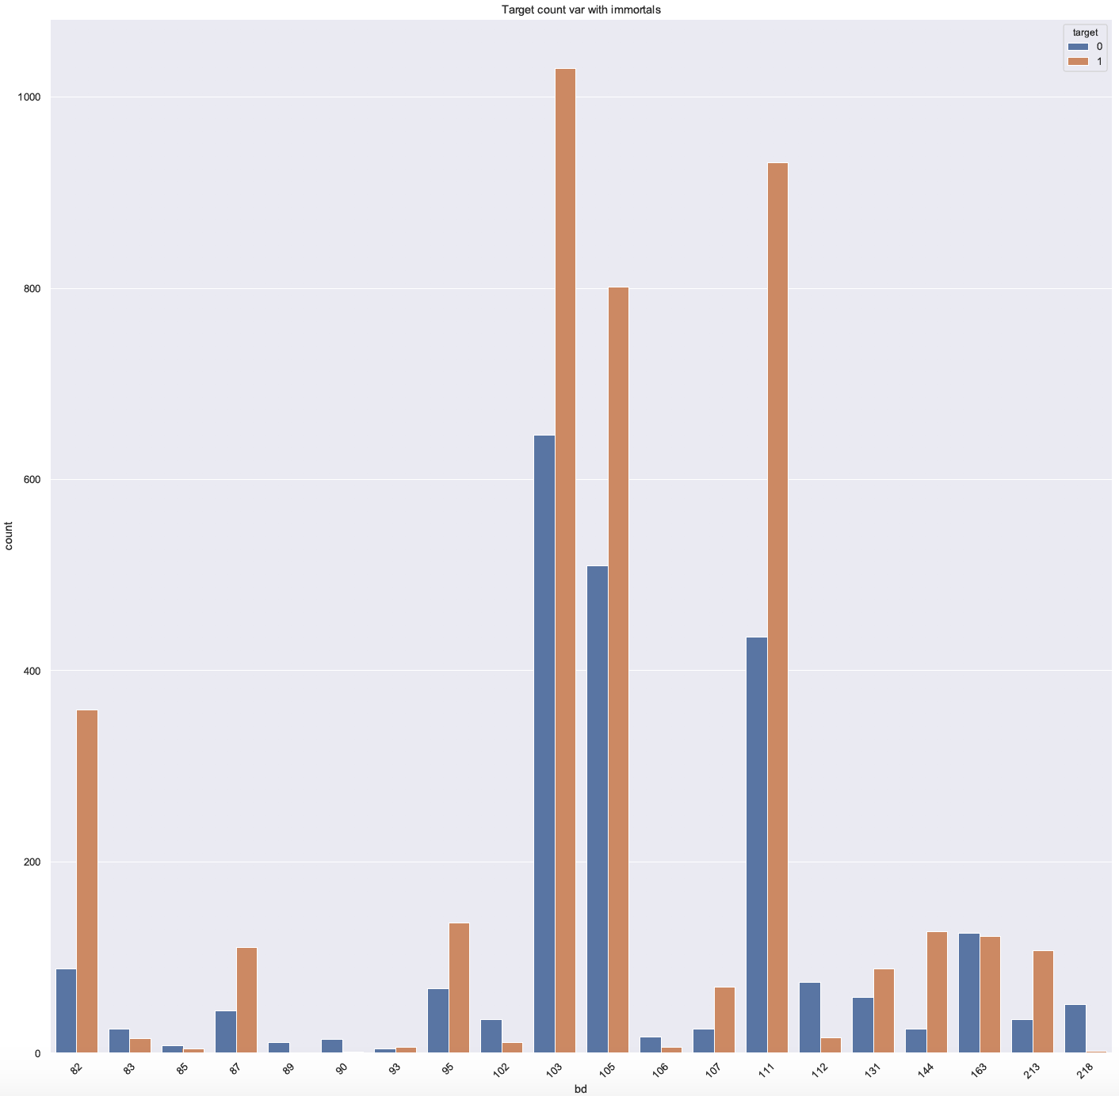
TARGET COUNT VARIATION: IMMORTALS

Slide 15
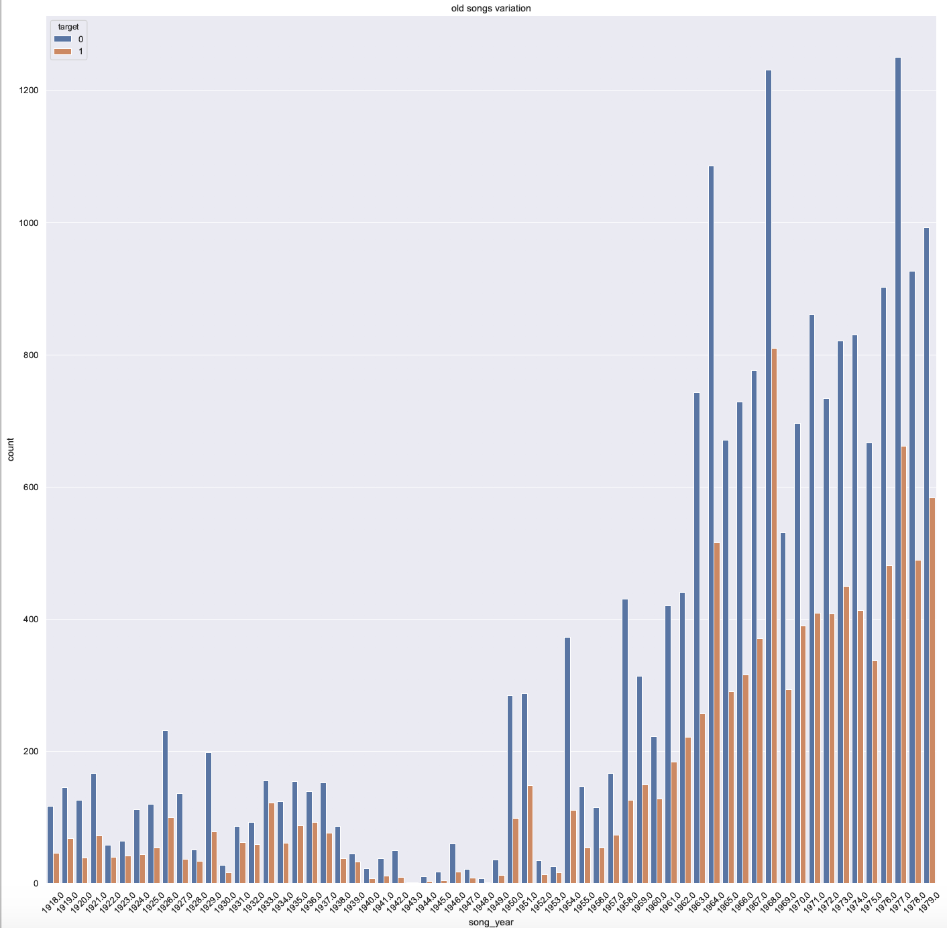
OLD SONG VARIATION: SONG YEAR

Slide 16
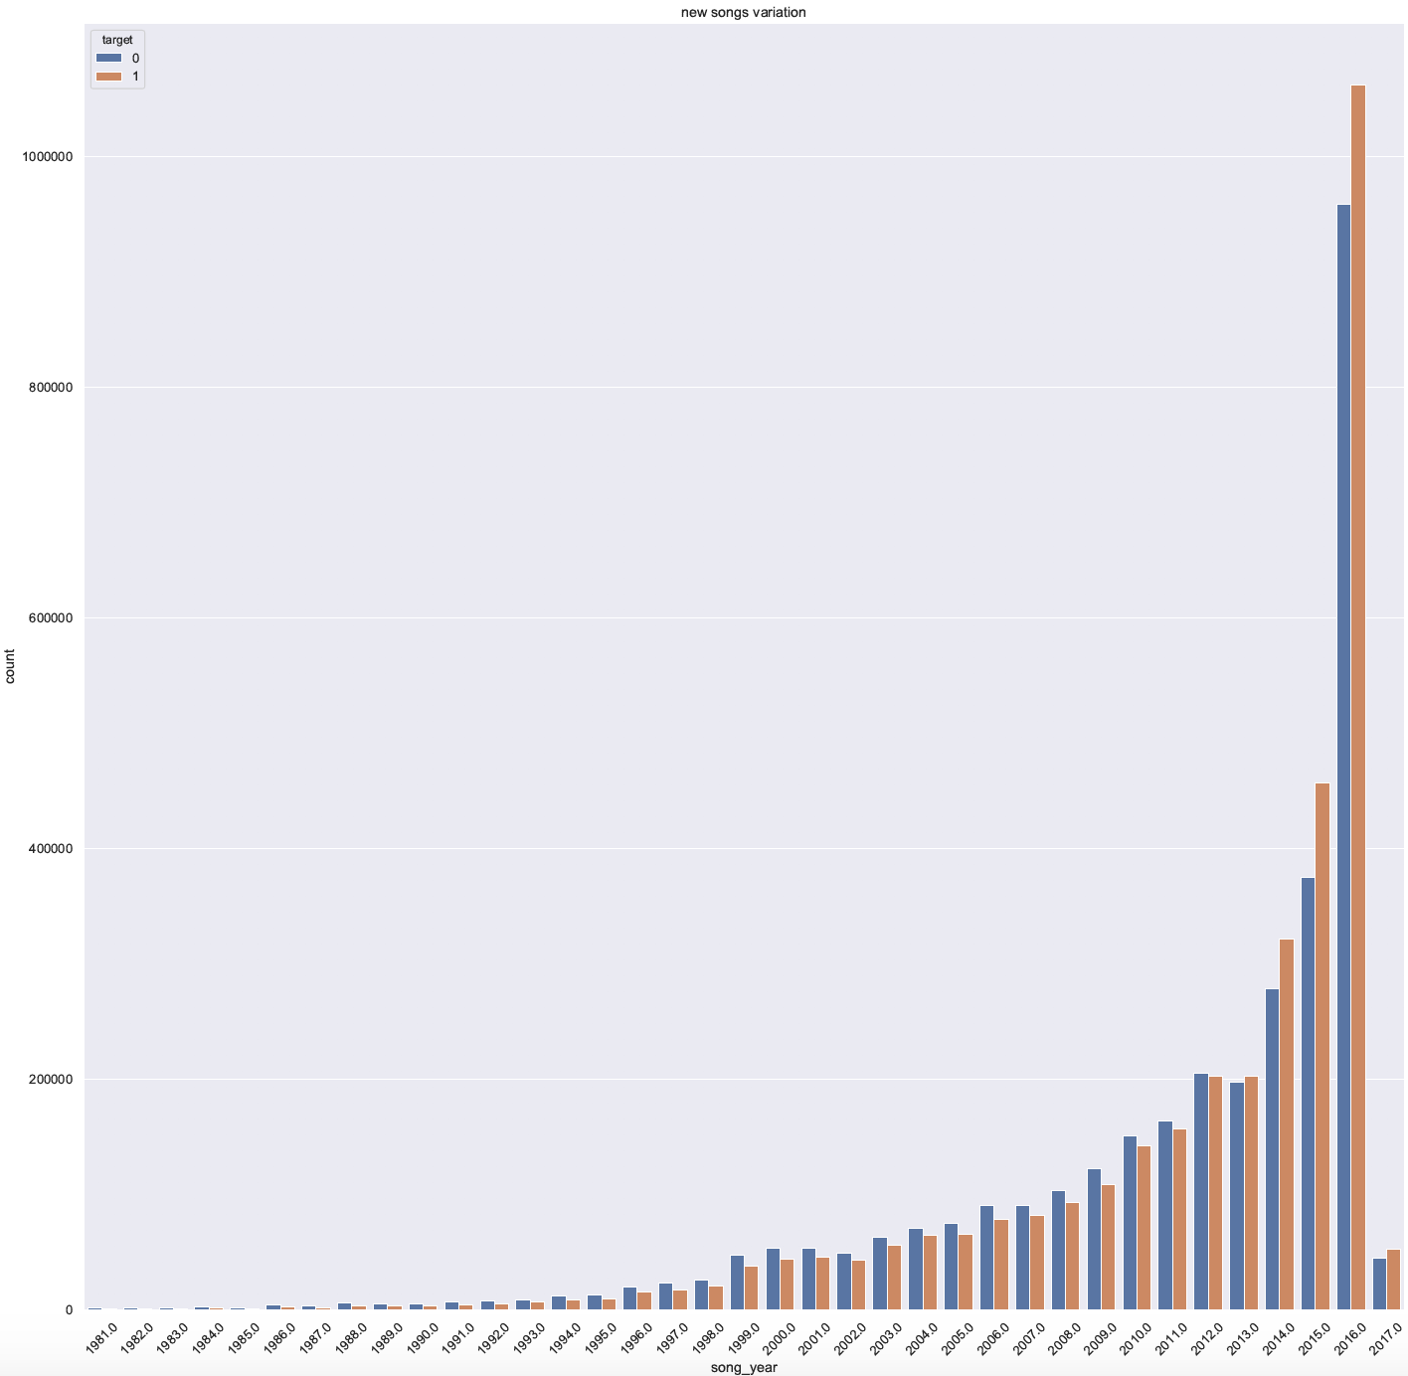
NEW SONG VARIATION: SONG YEAR

Slide 17
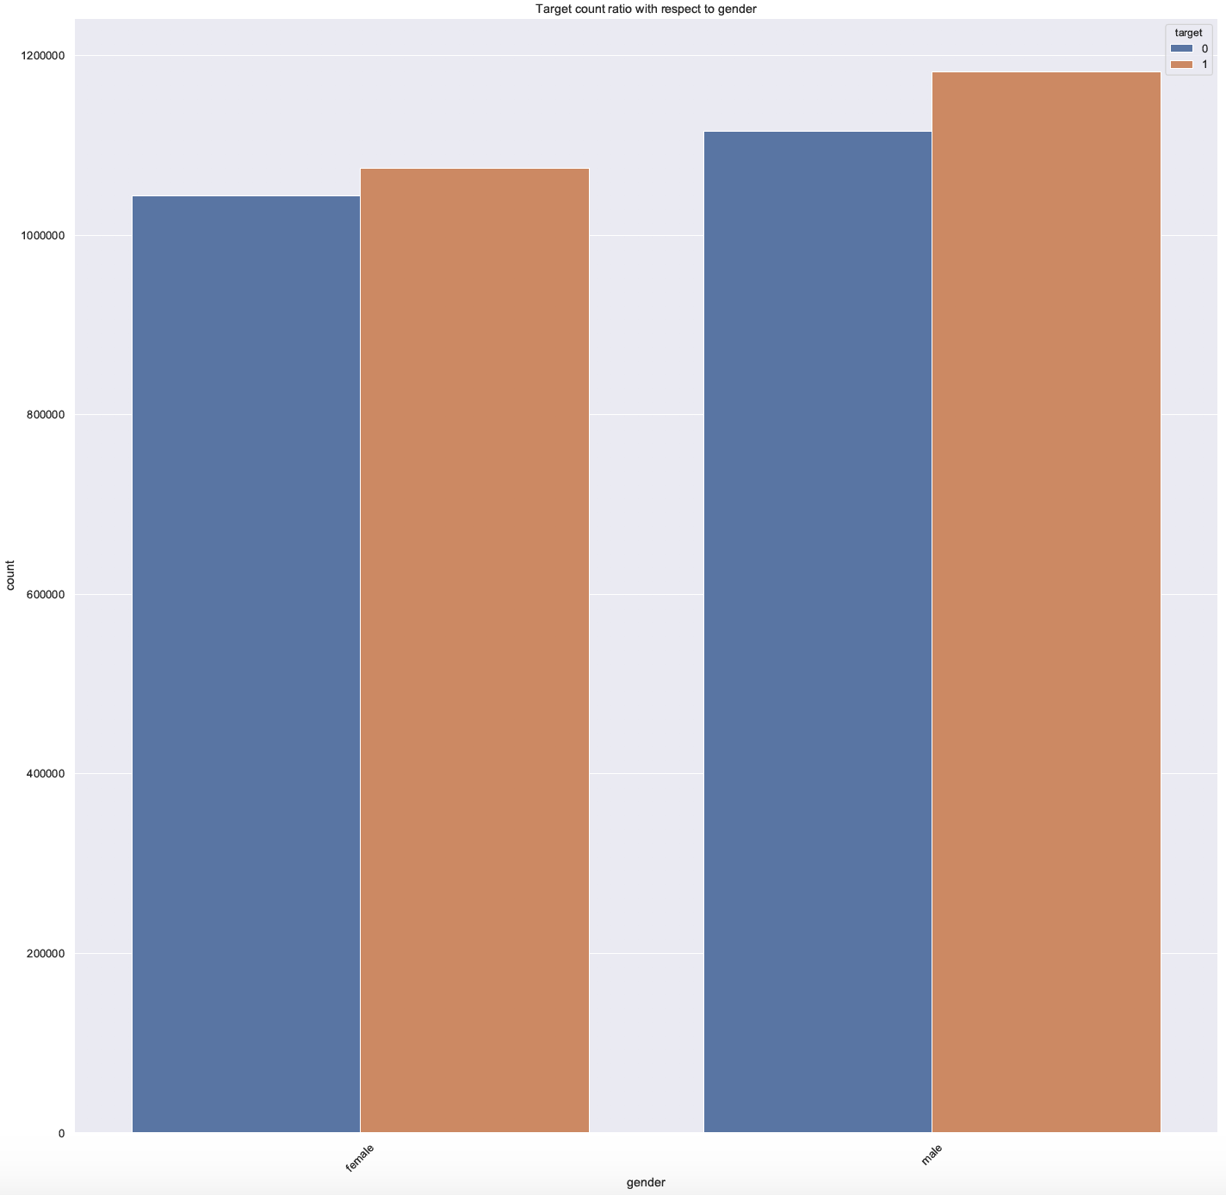
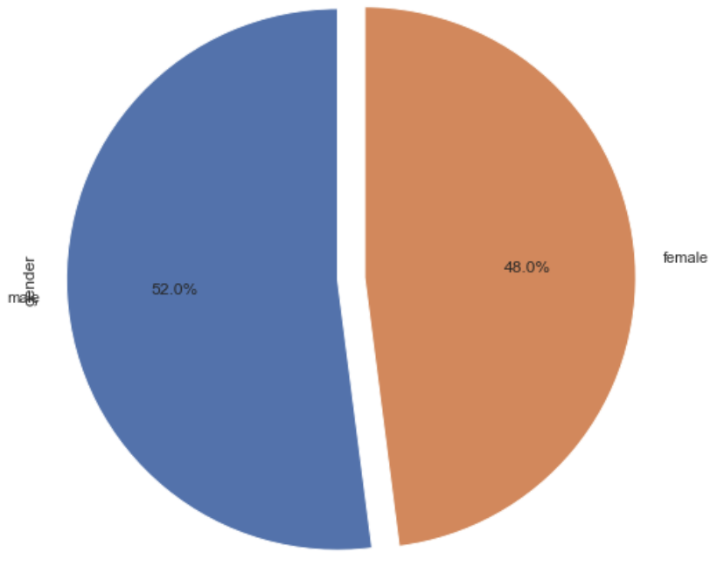
TARGET COUNT VARIATION: GENDER
GENDER RATIO

Slide 18
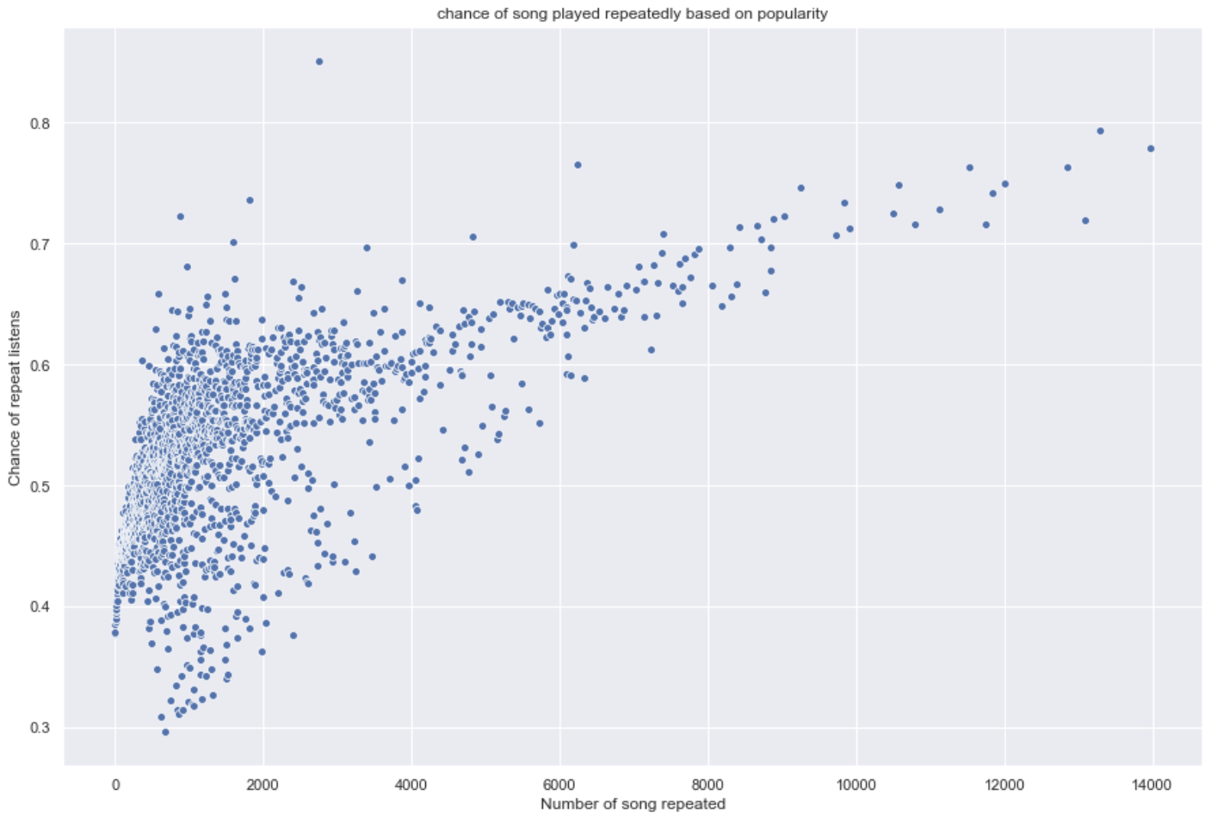
SONGS PLAYED REPEATEDLY BASED ON POPULARITY

Slide 19
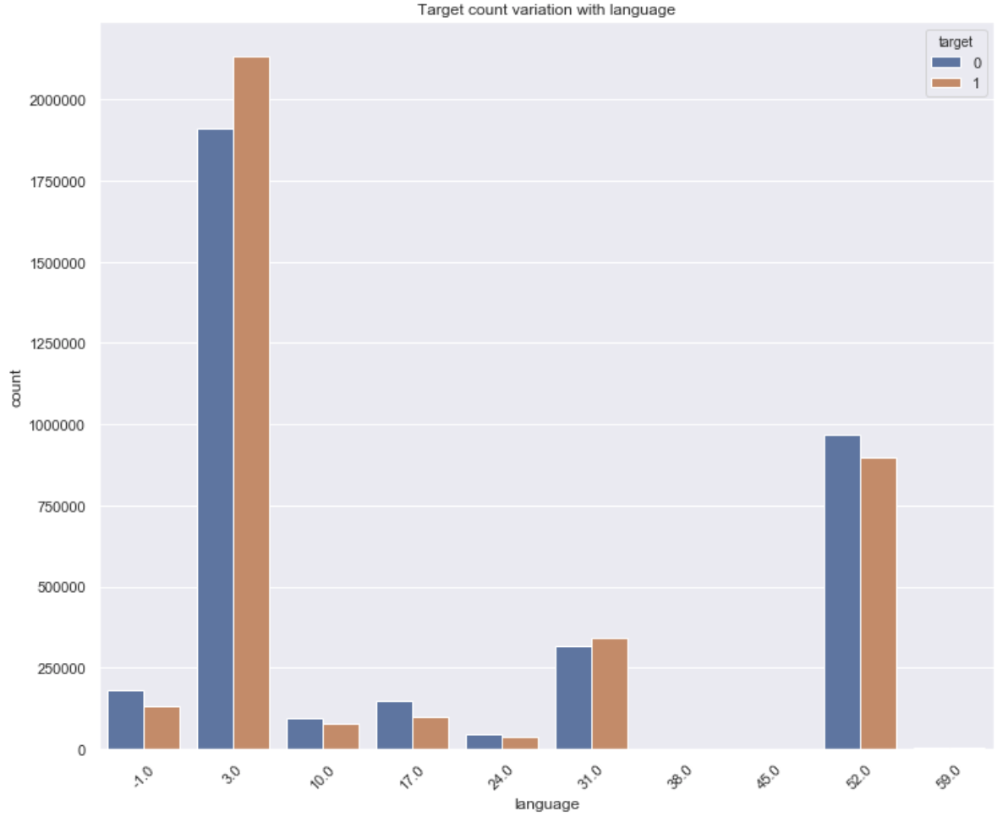
TARGET COUNT VARIATION: LANGUAGE

Slide 20
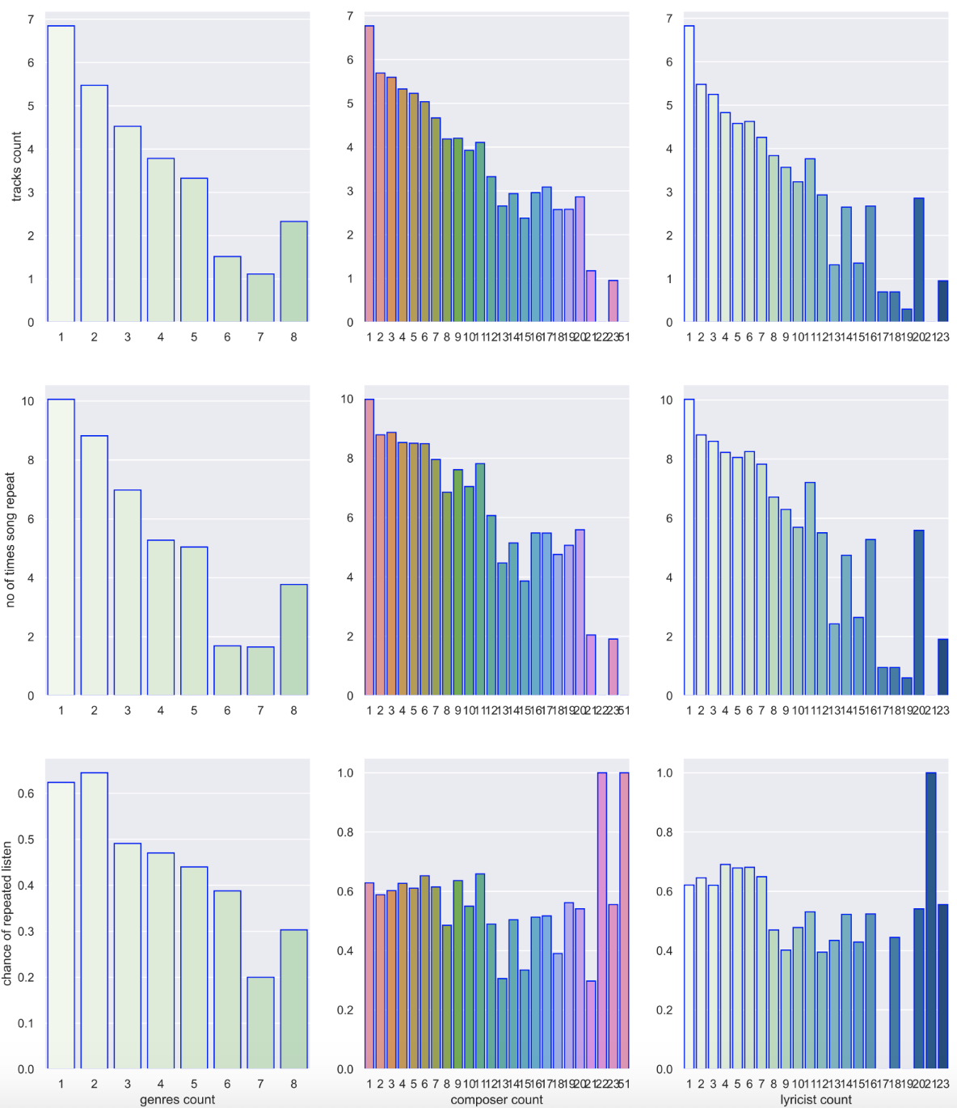
SONG VARIATION WITH GENRES, COMPOSER & LYRICIST

Slide 21
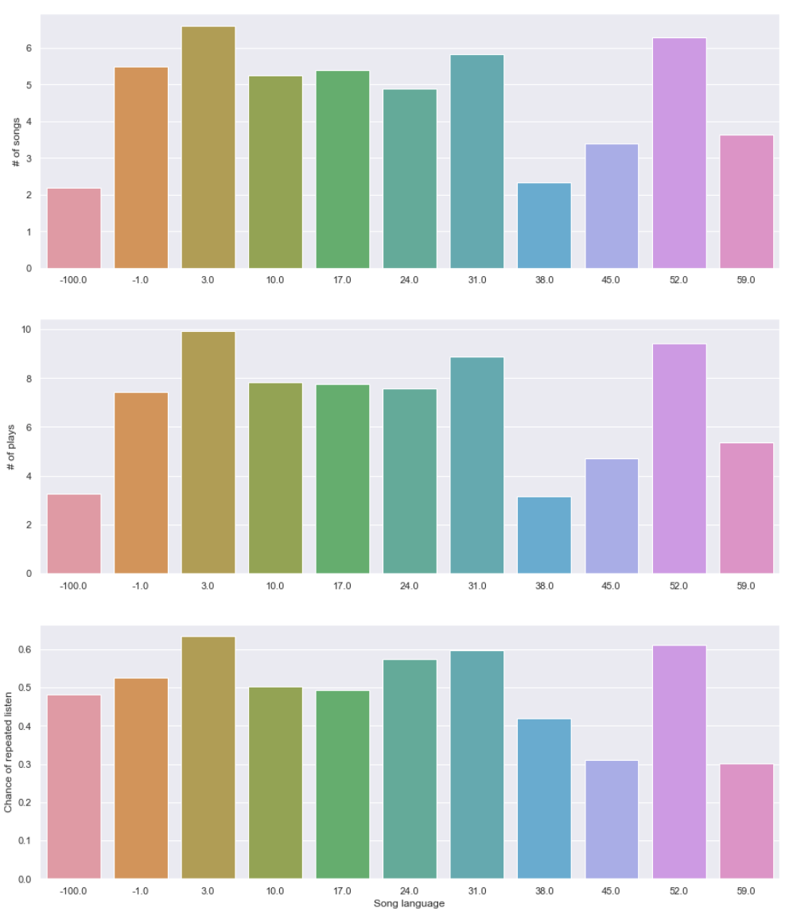
SONG VARIATION WITH LANGUAGE

Slide 22
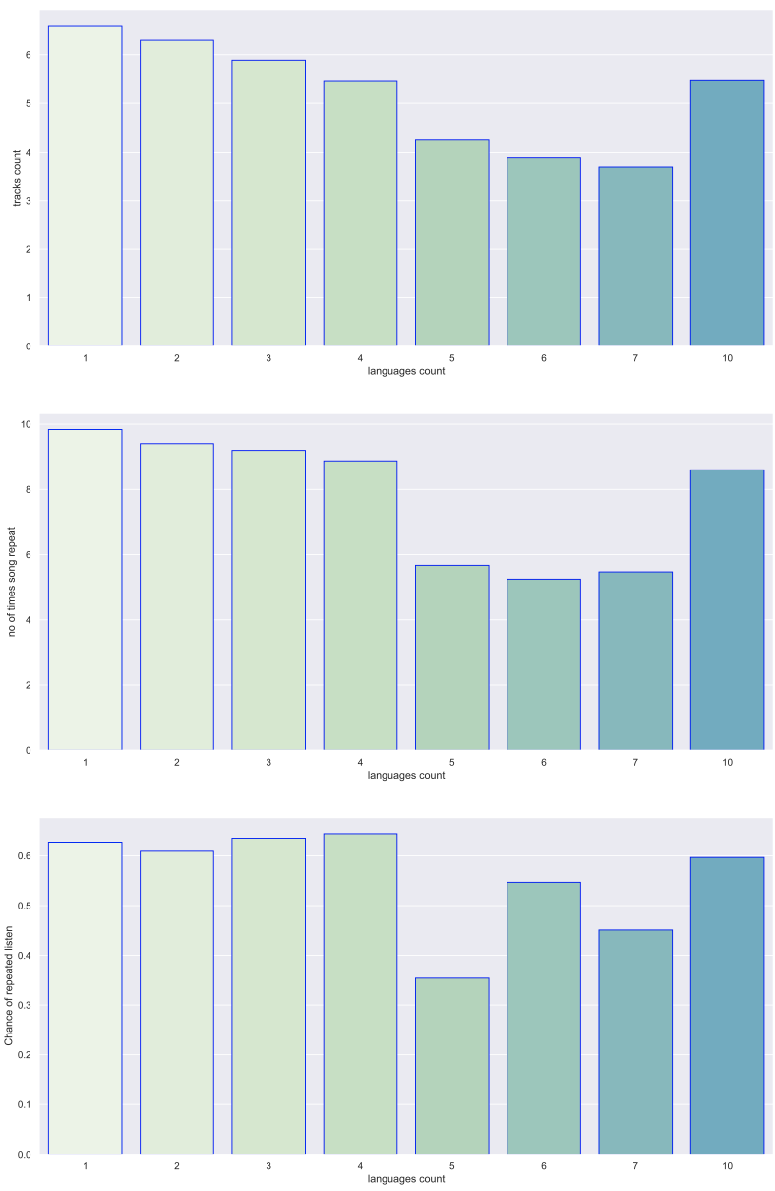
VARIATION WITH LANGUAGE COUNT

Slide 23
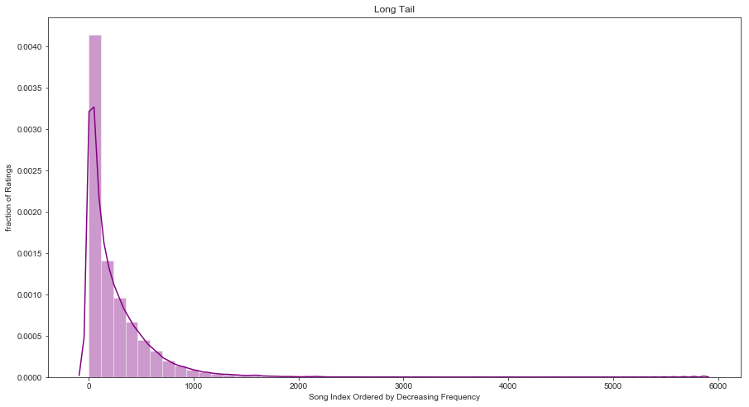
‘LONG TAIL’ DISTRIBUTION

Slide 24
EDA CONCLUSION
USEFUL FEATURES: 1. Number of genres a song has.
2. Number of composers and lyricists a song has.
3. Number of plays a song has.
4. The songs language.
5. The number of languages an artist sings in.
6. The song's length.
INFERENCE:
A ‘noisy’ correlation exists between number of songs played and chance of repeated listening. This could be due to a not very large amount of songs with a specific (large) number of plays.

Slide 25
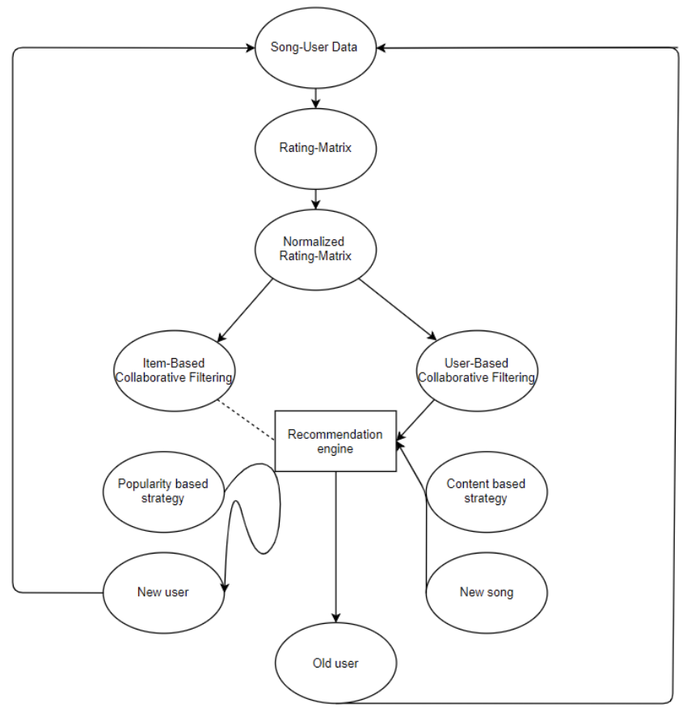
RECOMMENDATION SYSTEM

Slide 26
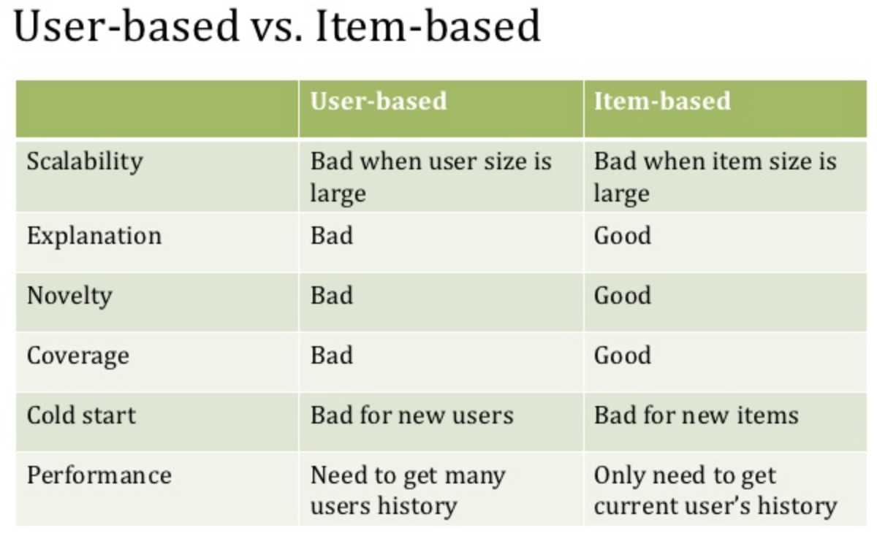

Slide 27
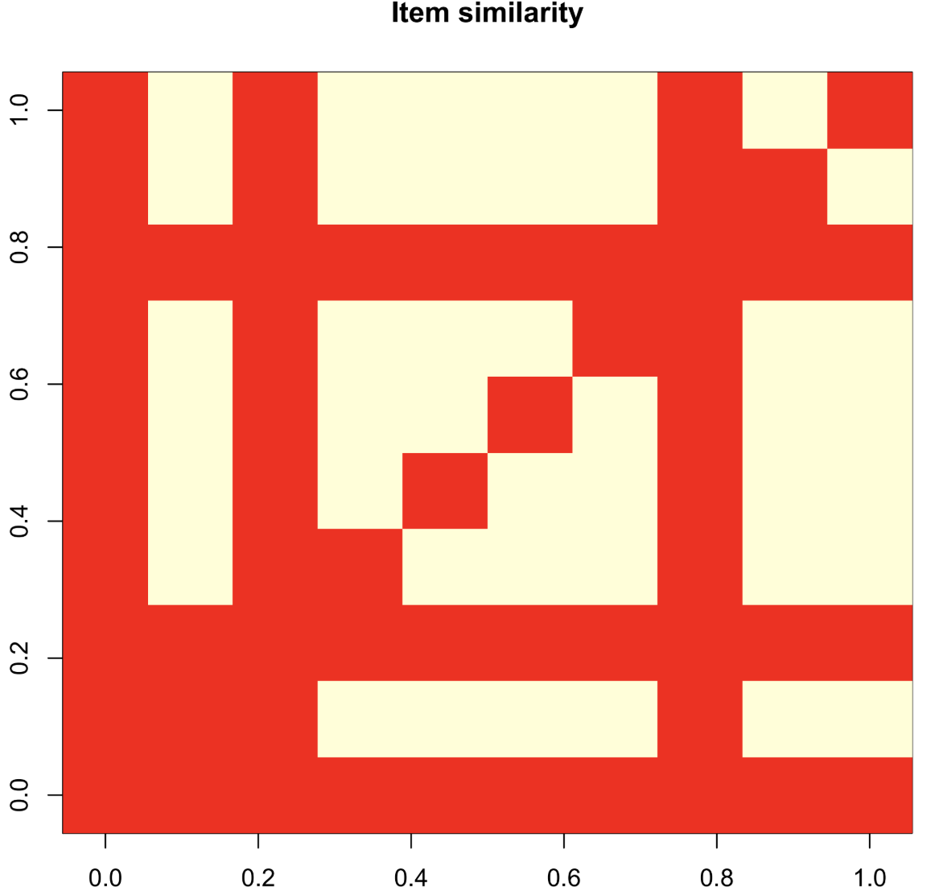
ITEM SIMILARITY MATRIX

Slide 28
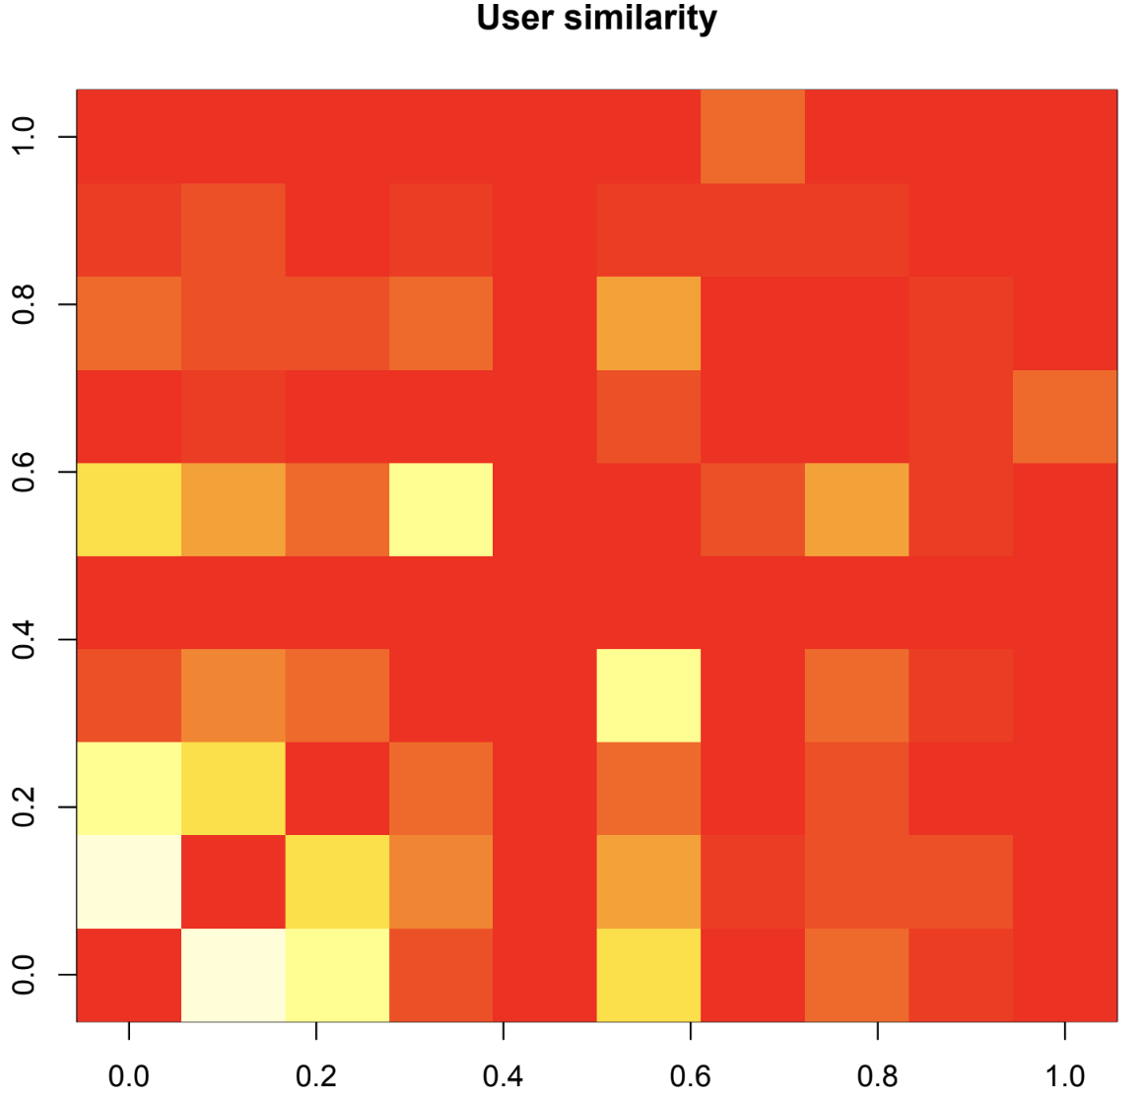
USER SIMILARITY MATRIX

Slide 29
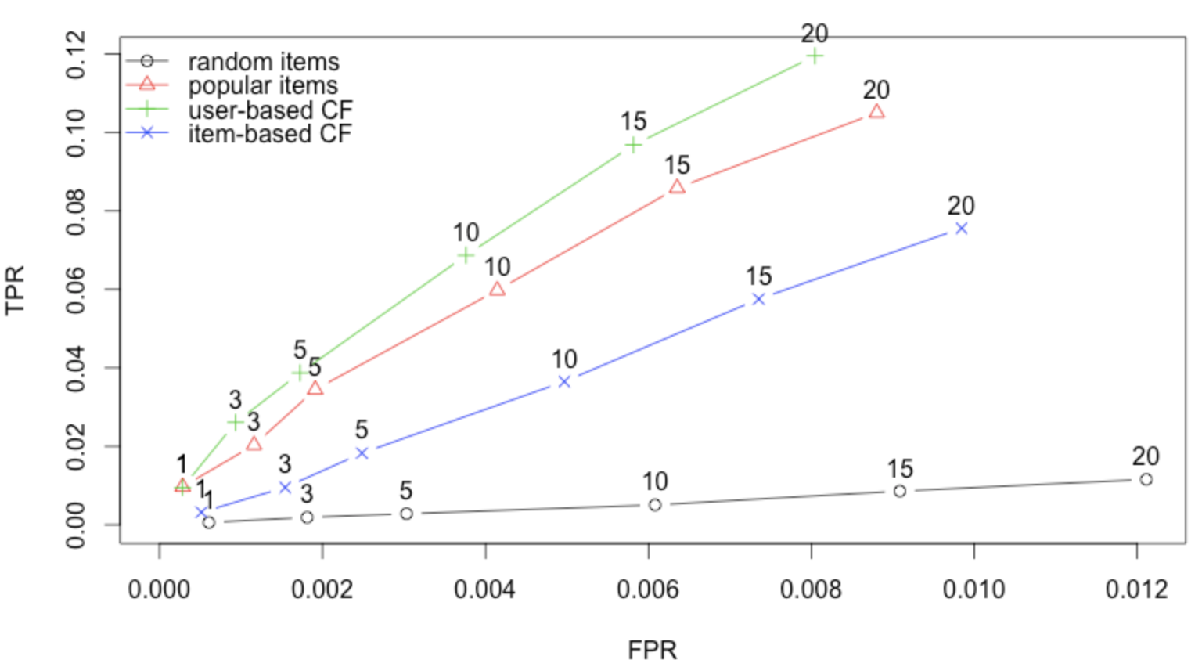
TPR – FPR GRAPH

Slide 30
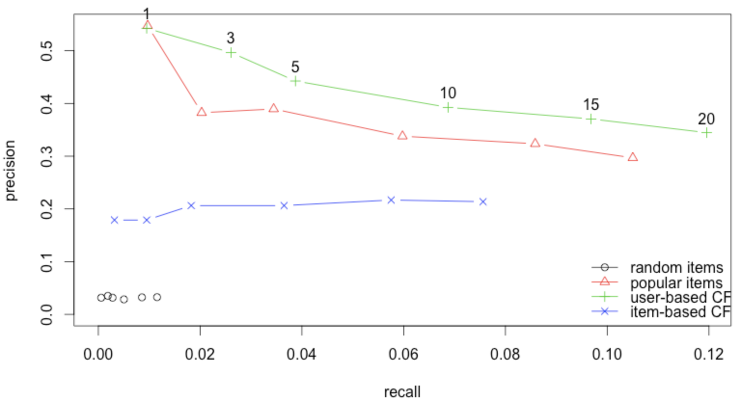
PRECISION RECALL GRAPH

Slide 31

CHALLENGES
1) Exploring large datasets using visualisation tools.
2) Learn the application of Time Series, Random Forest, XG Boost.
Metadata includes huge information and when exploring it, it is difficult to extract relevant features for song.
Processing such a huge dataset is memory and CPU intensive.
Recommending so many correct songs out of million songs for different users is not an easy task to get a high precision.
LEARNINGS
Exploring large datasets using visualization tools.
Building a recommender system is not a trivial task. The large scale dataset makes it difficult in so many aspects described under challenges.
Understanding of the large data set and how to work on it.

Slide 32


IN PRACTICE
For instance, a random user who recurrently listens to Britney spears’ Toxic was selected.
Our recommender system recommended:
Closer by the Chainsmokers
謝謝妳愛我 (Thanks For Your Love)
Here, After, Us by Mayday
Notes:
After taking a closer look, this user listens to Madonna, Michael jackson, and a whole medley of Asian artists.

Slide 33
CONCLUSION
UBCF did better than IBCF.
Moreover, UBCF would be preferred here as number of users are quite low and number of songs are large.
Item based model would have worked better if we would have enough memory and computational power to use the whole available metadata and training dataset.
RANDOM performed the worst.
When the song history of a user is too small to utilize the user-based recommendation algorithm, we can offer recommendations based on song similarity, which yields better results.
FUTURE SCOPE
Combine different methods and learn the weightage for each method according to the dataset.
Automatically generate relevant features.
Develop more recommendation algorithms based on different data (e.g. how the user is feeling, social recommendation, etc)

Slide 34
REFERENCES
https://www.kaggle.com/c/kkbox-music-recommendation-challenge/data
Kaggle competition Forum
https://www.kaggle.com/kunstmord/exploring-the-songs
https://www.analyticsvidhya.com/blog/2018/06/comprehensive-guide-recommendation-engine-python/?fbclid=IwAR0vVxyFjIMhKTfEoNAqaCG-PXaUpg1tVGsNSXcTqpKF9D6qdaSVpqidCzk
J. Konstan, S. McNee, C. Ziegler, R. Torres, N. Kapoor, and J. Riedl. Lessons on applying automated recommender systems to information-seeking tasks. AAAI Con- ference, pp. 1630–1633, 2006.
C. C. Aggarwal. “Recommender Systems” Springer. 2016
https://www.kaggle.com/plarmuseau/simple-recommender-pivot-tfidf-cossim?fbclid=IwAR0zCFP1Z7NEKCiemFejblreCN4sOU-FGlz5kx011fXjdQqjCU2v3JSkO2o
Google, of course.

Slide 35



